Slide 1
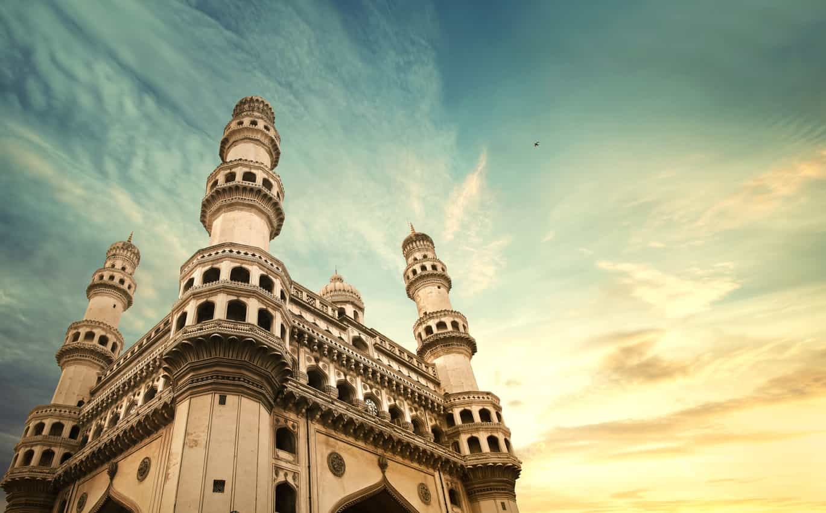

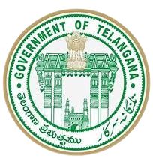

Telangana Tourism
Insights
Project by- Simranjit kaur

Slide 2
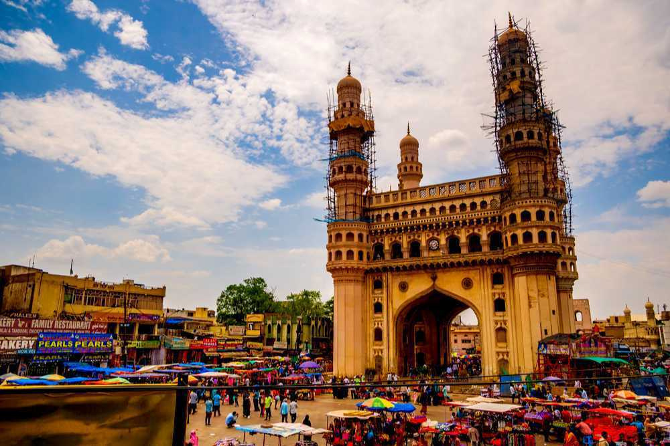
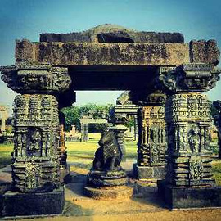
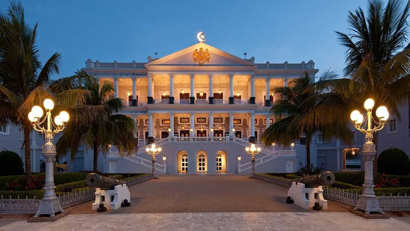
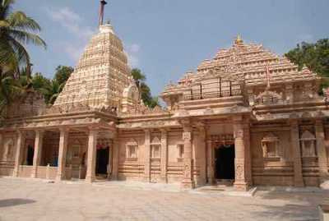
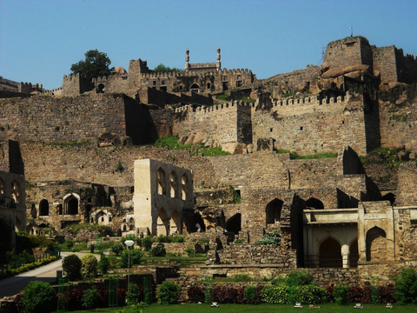
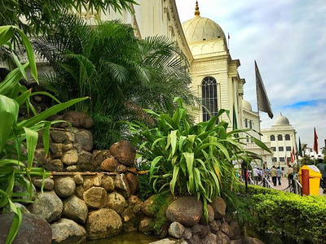
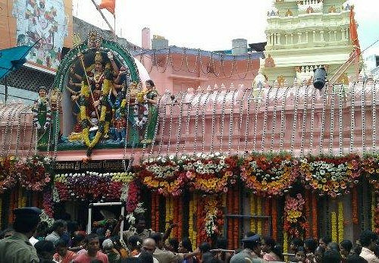
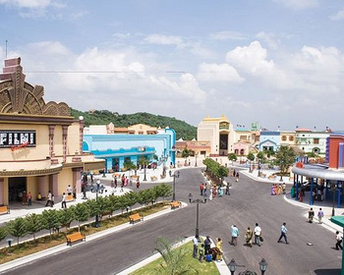
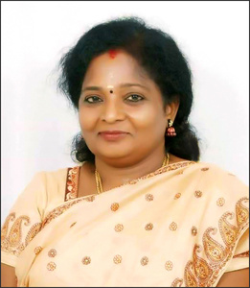

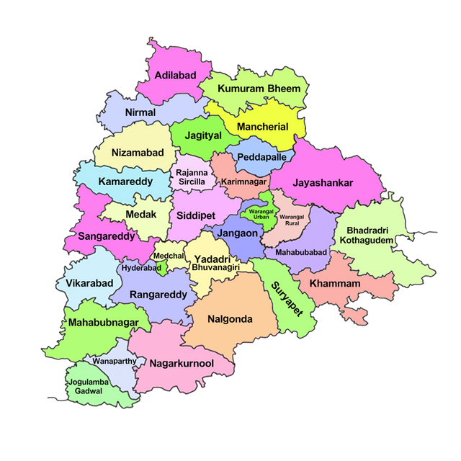
Charminar
Hyderabad
Warangal Fort
Warangal
Taj Falaknuma Palace Hyderabad
Pangallu
Nalgonda
Golconda Fort
Hyderabad
Salar Jung Museum
Art Museums
Ujjaini Mahakali Temple
Secunderabad
Ramoji Film City
Hyderabad
Dr. (Smt.) Tamilisai Soundararajan
Governor
Sri Anumula Revanth Reddy
Chief Minister
Telangana came into its own as India’s 29th state on June 2, 2014, in a historic moment that echoed the aspirations and resilience of its people. This vibrant state, born out of the spirited struggle for identity, has since blossomed into a dynamic blend of tradition and modernity, captivating hearts with its unique charm. Hyderabad (also known as Bhagya Nagaram) is the fifth largest metropolis of India and the capital of the states of Telangana . It is known for its rich history and culture with monuments, mosques, temples, and a rich and varied heritage in arts, crafts and dance. Also known as The City of Nizams and The City of Pearls, Hyderabad is today one of the fast-developing cities in the country and a modern hub of IT, ITES, and Biotechnology.

Slide 3
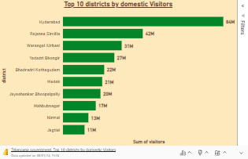
Telangana Tourism
Insights
1.
Top 10 districts that have the highest visitors overall (2016-2019)

Slide 4
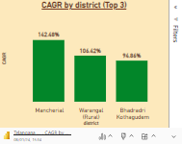
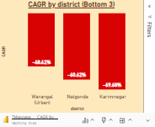
2.
Top 3 districts based on compounded annual growth rate (CAGR) of visitors between (2016-2019)
3.
Bottom 3 districts based on compounded annual growth rate (CAGR) of visitors between (2016-2019)

Slide 5
4.
What are the peak and low season months for Hyderabad overall between (2016-2019)?

Slide 6
5.
Show top and bottom 3 districts wrt domestic to foreign tourist ratio

Slide 7
6.
Top and bottom 5 districts based on population to tourist footfall ratio in 2019

Slide 8
7.
What is the projected number of domestic and foreign tourists in Hyderabad in 2025 based on the growth rate from previous years?

Slide 9
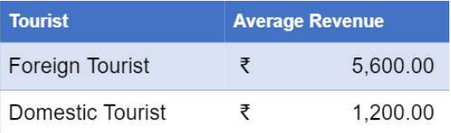
8.
Estimate the projected revenue for Hyderabad in 2025 based on average spend per tourist (approximate data).

Slide 10






Infrastructure
Development
Rating
Cleanliness
Rating
Crime
Rates
Swachh Sarvekshan 2022-Hyderabad Ranked 10th amongst top 20 cleanest cities in India over 1 million population
The crime rate in Telangana state has increased to 8.97 per cent in 2023 as compared to 2022.
Amongst one of the fastest-growing states in India, Telangana has registered a substantial growth of 19.1 per cent of Gross State Domestic Product (GSDP) valued at Rs 11.55 lakh crore. Telangana's nominal GSDP is 21.8 per cent higher in 2021-22 than the previous year, making it the sixth highest contributor to the national GDP.
During this year, the value of total property lost was Rs 151.78 crore, of which goods worth Rs 80.81 crore (53.82 per cent) were recovered, as compared to 50 per cent last year
In a major recognition, the top three high achiever districts under Swachh Survekshan Grameen for December 2022 turned out to be from Telangana.
Cyber crime has increased to 17.59 per cent in overall crime rate in the state.
While Rajanna Siricilla stood first, followed by Karimnagar district in the second position and Peddapalli district in the third position of the ranking.
The overall conviction rate was 41 per cent and life conviction has increased 39 per cent this year.

Slide 11
9.
Districts with highest potential for tourism growth

Slide 12
10.
Cultural/Corporate events to boost tourism growth

Slide 13
Dubai
Tourism
Model
How can Hyderabad emulate the Dubai model?

Slide 14
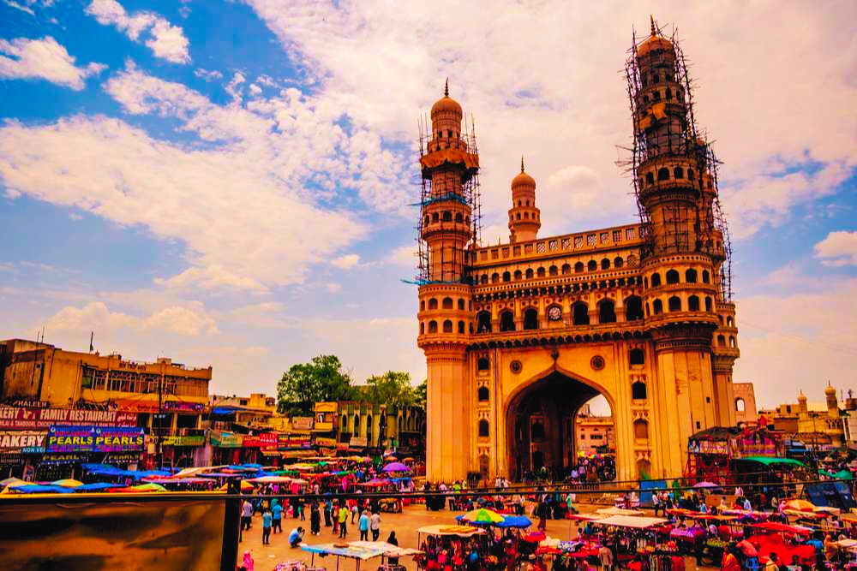
Telangana- Harmonising heritage with Modern Brilliance

